Slide 1
Miller’s
Career Accelerator
$UPERCHARGE YOUR COLLEGE JOURNEY FOR BIG CAREER WINS

Slide 2
The KEYS to Getting That Amazing Job (and multiple job offers) at Graduation
Get MULTIPLE SCM Internships
Be an ACTIVE member of SPO (Bauer’s Supply Chain Management Student Organization)
  Attend as many events and workshops as possible
  Participate in BOTH the Mentorship and Family Programs
  Volunteer to help with a committee
  IDEAL: Be an officer, directing a committee
spobauer.org linktr.ee/spobauer
Have an extensive friend group (network)
  Bauer SCM Students
  Bauer SCM Alumni
  SCM Industry Professionals
Treat your Job Search like an extra “class”
  Schedule a minimum of 3 hours per week
  Make time for an additional 2 – 5 hours
  Do not skimp
Use ALL your resources:
  Bauer Rockwell Center network and Career Fair
  SPO Networking Events and Career Fair
  LinkedIn Networking and Job Postings
  Indeed, Glassdoor, ZipRecruiter, Monster Job Postings

Slide 3
TODAY (And where to learn more)
Describe the Features of a Great Resume (You MUST have a great resume to get an interview and EVERYONE can have a great resume)
Describe how to do good Networking (This is the hidden secret of a successful job search)
Interviewing Overview (Some advice … and the best way to gain this skill is to do it!)
spobauer.org … click on Career Resources and Explore MORE
Microsoft CoPilot … AccessUH Login, Click on Microsoft 365 Tile
ChatGPT … AccessUH Login, Click on ChatGPT Tile

Slide 4
Create a Great Resume
Get a recruiter’s attention when you are applying for jobs

Slide 5
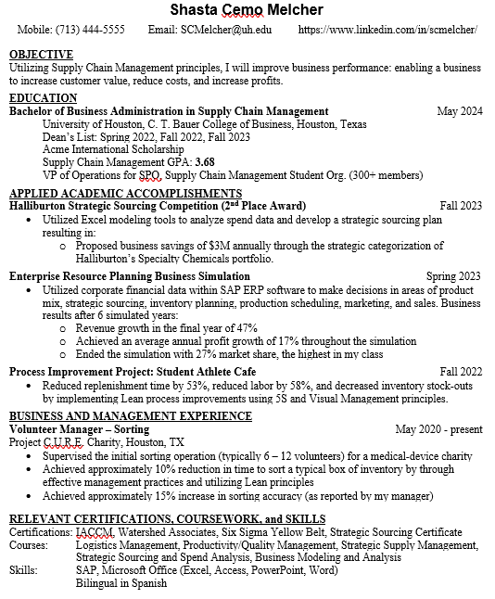
What is the Purpose of a Resume?
A great resume will not earn you a job. A great resume earns you a phone call.
You have only 10 – 20 seconds to make an impression on your resume:
  Every item on your resume must make an impact
  The most important things about you must be obvious
  EVERYTHING worded to deliver value for the hiring manager
  Use bolding, italics, font size, indention to highlight key aspects
Recommended Sections of a Resume
  About you and your education
  Your Supply Chain Management – Related Experiences
  Certifications, Coursework, Skills
  *See spobauer.org for multiple examples of organization and headings

Slide 6
What is the Purpose of a Resume?
A great resume will not earn you a job. A great resume earns you a phone call.
You have only 10 – 20 seconds to make an impression on your resume:
  Every item on your resume must make an impact
  The most important things about you must be obvious
  EVERYTHING worded to deliver value for the hiring manager
  Use bolding, italics, font size, indention to highlight key aspects
Recommended Sections of a Resume
  About you and your education
  Your Supply Chain Management – Related Experiences
  Certifications, Coursework, Skills
  *See spobauer.org for multiple examples of organization and headings

Slide 7
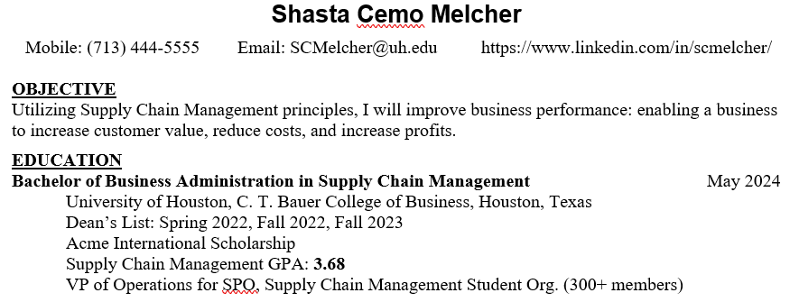
Resume Header Sections
Contact Information
  Make it easy for the hiring manager to contact you
Objective Statement (Optional)
  Focus on what you can do for the hiring manager
  Focus on what excites you about supply chain
Education / Honors / Awards
  Include Degree Concentration Certificates you intend to earn
Customization
  If you have lots of honors and awards, you can create a separate section for these.
  If you have a GPA you are proud of, include it on your resume.
  If your GPA is less than 3.4, either:
    Do not include it
    Recalculate your SCM Courses GPA if it is higher
  If you were working to put yourself through school, include this statement
  If you were working full/part time while taking classes, include this statement

Slide 8
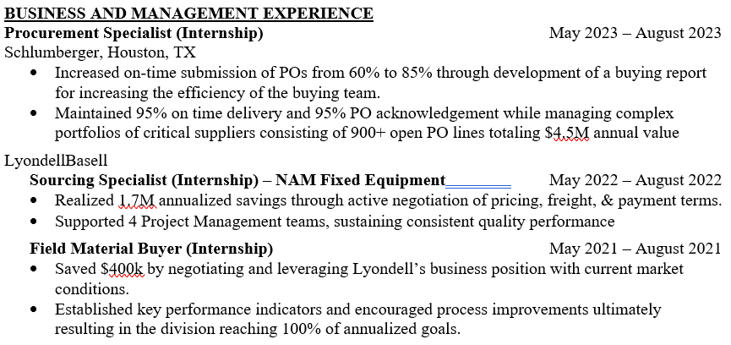
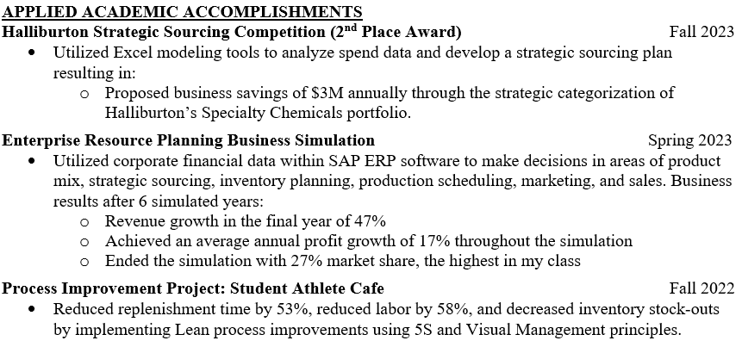
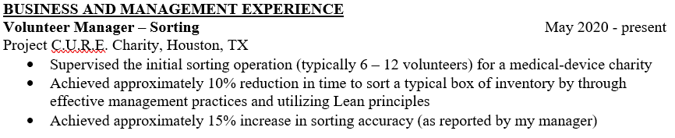
The Most Important Section:
Your Supply Chain Management Experience
The BEST Experience – REAL Supply Chain Management in a Business
  Previous SCM Internships and Co-Ops
  SCM-Related Jobs: Construction, Manufacturing, Warehouse, Delivery
    Learn More: Matthew Ochoa: https://www.linkedin.com/in/matthew-j-ochoa/
Don’t have an Internship or Co-Op? Use SCM Course Projects
Don’t have SCM Course Projects? Use any jobs or volunteer experiences you’ve had previously.
Tips and Tricks
  Customize the category title to match your experience
  Customize your job titles to reflect your job roles
  MUST include quantitative achievements and accomplishments
  Use the most space on your resume for your most impressive experiences
  Avoid just listing “tasks”
  Keep text for bullet items on one line

Slide 9
How to determine your Accomplishments and Achievements
Internship or Co-Op:
  Performance Measurements (for yourself, your business unit, the company as a whole)
  Calculate improvements made over the course of your work
Estimates of improvements and the impact of accomplishments
Reports or Recommendations to Management
  Projected Savings or Projected Outcomes are your accomplishments
Member of a work group or team:
  The Accomplishment of the team is YOUR accomplishment
Need ideas or a creative memory jogger?
  Feed everything you can remember about your job into Microsoft CoPilot or ChatGPT
  Ask it to remind you of things that could be considered numerically measurable accomplishments or achievements

Slide 10
CoPilot or ChatGPT AI Prompt Example to get you started
I need your help finding accomplishments to put on my resume. I cannot remember any accomplishments that I had and I need your help discovering what I may have accomplished. I am trying to get jobs related to Supply Chain Management, so accomplishments that could be associated with Supply Chain functions are preferred. Accomplishments should be things that I can quantify numerically such as percent improvements or dollars saved. I recently had a job [describe your job, where you worked, and what you were responsible for] Give me a list of potential accomplishments that you think I could have made and may have forgotten about. Describe these accomplishments in Supply Chain related terms, but also make the wording clearly associated with the job role that I described for you.

Slide 11
Turn part-time jobs and volunteer work into Supply Chain Management Experience
(almost) EVERY job is a Supply Chain Management Job
  Supply Chain Management is the “doing” function in a business.
  It is likely that whatever you were “doing” in your part-time job or volunteer work was related to Supply Chain Management
  Use Supply Chain Management Industry Jargon and Wording to describe your work
DISCLAIMER: Never lie or misrepresent your experiences on a resume
  Be honest – and represent yourself the best you can
  If you feel uncomfortable with anything – do not include it
  Remember – in an interview, you will be asked about each item on your resume: be prepared to be able to talk about your story

Slide 12
Use Artificial Intelligence (Microsoft CoPilot or ChatGPT) to help reword difficult job & volunteer experiences
Feed your best and most complete description of your job or volunteer experience and your role into CoPilot.
Ask for suggestions for creative titles that are related to Supply Chain Management
Ask the AI to reword your experiences and tasks into a bullet list of activities that are related to Supply Chain Management
Be specific about what you want: a description for a resume that accurately describes your job but also relates the work to Supply Chain Management
Don’t forget about accomplishments!
Example: Starbucks Barista
  Alternate Job Titles:
    Retail Operations Associate
    Order Fulfilment Specialist
  Alternate Job Task Wording:
    Inventory analysis and replenishment
    Real-time demand fulfillment
    Responsible for last-mile service delivery
  Possible Job Accomplishments:
    Contributed to a X% increase in peak hour throughput by optimizing order sequencing
    Improved customer satisfaction scores by X%
    Reduced product waste by X% through accurate daily forecasting
    Accelerated order processing time by X% by streamlining workflows

Slide 13
Certifications, Skills
External Industry Certifications
LinkedIn Learning Courses
  Certificate of Completion
  Professional Certificates
Technology
  Software
  Data Analysis Skills
Languages

Slide 14
Finishing Touches
Share your resumes within groups of friends (such as your SPO Family!)
  You’ll learn a lot about what a great resume looks like
Show your resume to someone who does not know much about you
  Let them look at it for 5 seconds
  Ask them what stood out about your resume
  Ask them what they think is your most impressive accomplishment
Mirror your Resume on your LinkedIn
  You have more space on LinkedIn to provide details if you feel that will be helpful

Slide 15
Networking
The secret superpower of the most successful job-seekers

Slide 16
Networking
The hidden secret of a successful job search
Job search tasks:
  30% Applying for Jobs
  10% Updating your Resume and LinkedIn
  20% Researching Specific Companies
  15% Interviewing
  25% Networking
    And if you are not interviewing, do more networking
What is Networking?
  Networking is simply making Professional Acquaintances and Friends

Slide 17
How to get started Networking
(do this every week)
Use LinkedIn Search Filters to find exciting people in exciting jobs at exciting companies
  Locations
  Current Company
  All Filters:
    Connections of “Bradley Miller”
    School: “University of Houston”
    School “Bauer College of Business”
    Title Keywords
  Each Week, send 5 – 15 – 30 connection requests to people YOU find interesting (more is better)
Once Connected:
  Send a “Thank You” DM for connecting
  After at least a week, send a DM requesting a short, 10-15 minute conversation
    Script ideas in my Networking Document
  Have a short conversation – focus the conversation on them and their role and their experiences. NOT you.
  Limit the conversation to 15 minutes to respect their time. Tell them “thank you.”

Slide 18
How to continue the relationship
Watch their LinkedIn for updates and posts
  Engage with their content with likes and thoughtful comments
  Send a DM to congratulate or request a conversation to learn more
Tell them about your own accomplishments and LinkedIn updates and thank them for giving you inspiration/advice
Watch the news for events happening at their company
  Send a DM to request a conversation to learn more
Share relevant articles or news if it reminded you of them
Ask for advice on a specific situation (MAX every 4 – 8 weeks)

Slide 19
Does Networking Really Work?
Jesus Arguelles
  First-Gen College Graduate
  Bauer Supply Chain Management Major
  Six Internships and additional internship offers
  Multiple Job Offers Upon Graduation from MAJOR companies
  Turned all these offers down for his DREAM job at L'Oréal
  https://www.linkedin.com/in/jesusarguelles/
  Regularly posts advice for getting internship and job offers

Slide 20
Being your Best you in an Interview
Setting yourself apart
from the competion

Slide 21
Interviewing Overview
Details with questions and sample answers in my Interviewing Advice Handout
Know your resume. Know stories related to your resume.
PRACTICE – PRACTICE - PRACTICE:
  Use Practice Questions from my Interviewing Handout on spobauer.org
  Ask Microsoft CoPilot to give you a Mock-Interview, a Full Simulated Interview, or Targeted Practice for specific question types (CoPilot will give you feedback, too)
  Attend Bauer Rockwell Center and SPO Mock Interviews
  Attend ALL the Career Fair Events you can possibly attend
  Apply for jobs and interview
START method for telling a story
  S Situation: Set the scene
  T Task: Describe the challenge and your role and purpose
  A Action: Explain what you did
  R Result: Share the outcome with numerical metrics if possible
  T Takeaway: Share the lesson learned and how you could apply this knowledge in the company with which you are interviewing

Slide 22
Take Advantage of Upcoming
SPO And Bauer Events
Getting Interviews is a Numbers Game: Apply For LOTS of Jobs
SPO Supply Chain Management Student Organization
  SPO Career Fair
  Student Development Workshops
  Career Mixers
  General Meetings
Bauer Rockwell Center
  Bauer Career Fair
  Workshops: Build a Resume, Mock Interviews
  Recruiter Meet & Greets
    Live Nation Entertainment, Academy Sports, etc.
  Free Professional Headshots
Spring Semesters: University of Houston STEM Career Fair
  SCM is “Engineering Degree or Equivalent”

