Slide 1


WELCOME TO
SCM Pathway Planner:
Bauer Course Plans to be Job-Ready

Slide 2
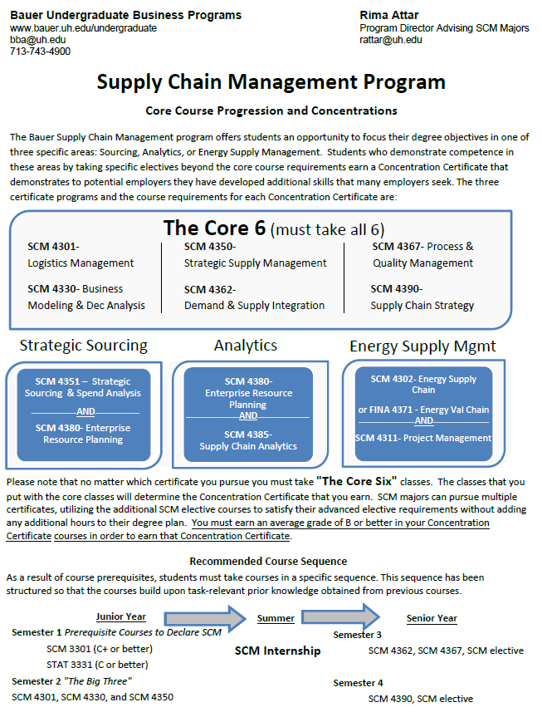
HISTORY OF CURRICULUM DEVELOPMENT
  Designed to give you hands-on learning experience
  Courses include curriculum and learning objectives requested by industry professionals
  Requires Core 6 classes covering all foundational elements of Supply Chain Management
  Encourages valuable Academic Concentration Certificates to enhance your resume.
  Courses and sequence are designed to set you up for success

Slide 3
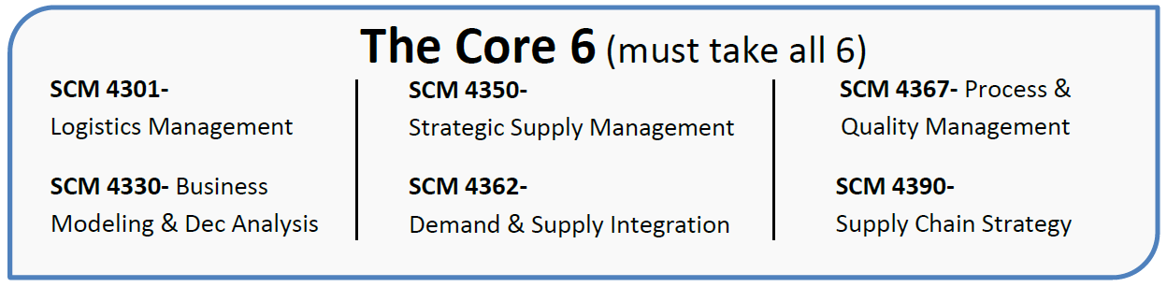
  Pre-requisites for SCM 4000 classes are:
    STAT 3331 – grade of C or higher
    SCM 3301 – grade of C+ or higher
  All six Core classes are required for a degree in SCM
  “Big 3”: SCM 4301, SCM 4330, SCM 4350
CORE 6 (REQUIRED SCM COURSES)

Slide 4
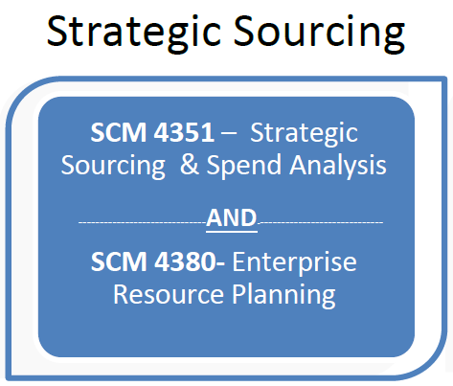
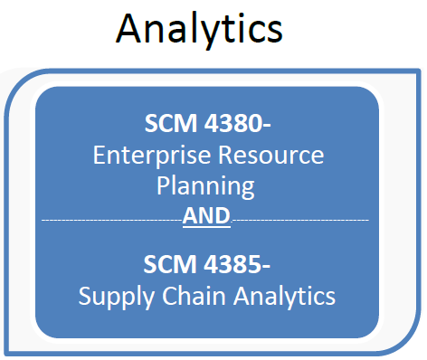
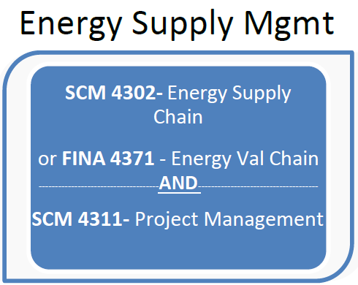
Supply Chain Management
ACADEMIC CONCENTRATION CERTIFICATES
  Job Titles:
  Procurement, Sourcing, Category Manager, Buyer, Contracts, Supplier Relationship Manager, Materials Management
  SCM 4351 includes two highly recognized case competitions
  SCM 4380 uses SAP – the most popular ERP system
  Job Titles:
  ERP Analyst, Systems Analyst, Digital Analyst, SCM Analyst, Demand Planning Analyst, Business Intelligence, Forecasting
  SCM 4380 uses SAP – the most popular ERP system
  SCM 4385 includes advanced analytical methods used by top companies.
  Jobs in Energy/Oil & Gas Industry:
  Exploration, Production, Oilfield Services, Pipelines, Natural Gas, Terminal Operations, Refinery, Lubricants, Renewables, Biofuels
  SCM 4302 & FINA 4371 expose you to how these Supply Chains are organized
  SCM 4311 is typically offered in the summer

Slide 5
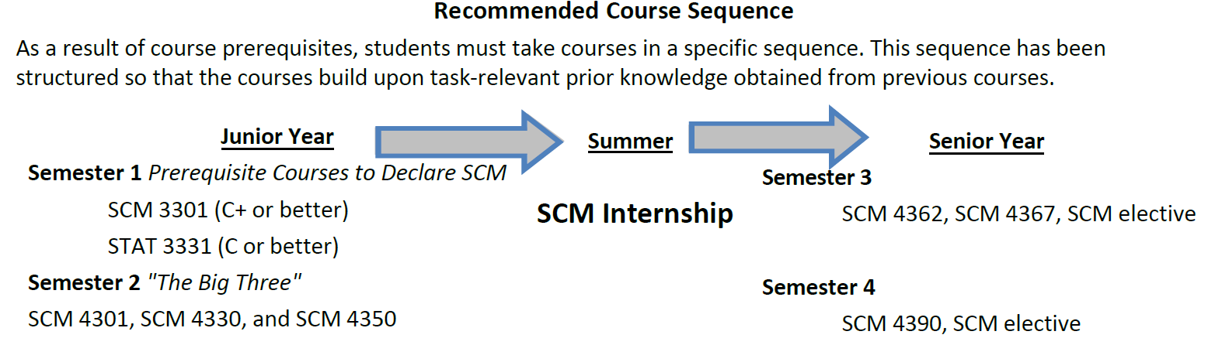
RECOMMENDED COURSE SEQUENCE
  Prerequisites for SCM Majors: STATS 3331 & SCM 3301 [Taught in Fall, Spring, and Summer]
  SCM 4330 (Business Modeling using Excel) is always taken in your first “in-major” semester to give you foundational analytics skills used in future courses.
  SCM 4350 is a prerequisite of SCM 4351 and is encouraged to be taken with SCM 4301 and 4330.
  If you are obtaining a Strategic Sourcing certificate, SCM 4351 is recommended to be taken in Semester 4.
  SCM 4362 is a pre-requisite/co-requisite for SCM 4380. It is recommended to take both classes in Semester 3.

